Slide 1


RESEARCH | PROJECTS | EXCELLENCE

Slide 2
Research
matters at FOI
FOI researchers mainly act in interdisciplinary field including social, technical and natural sciences within a number od research groups, centers and laboratories
FOI strategic areas include:
Information systems of the future, Internet of everything and related disciplines
Economics of entrepreneurship and innovation management
Management of organizations and business processes
Educational technologies
Big data analytics and artificial intelligence
Information security and open systems
70% of FOI staff is project-active, within different fields of research and different projects – from basic to applied

Slide 3

FOI Projects
Excellence is not a gift, but a skill that takes practice.
PROJEKTI.HR
IN 2021, FOI RESEARCHERS ARE ACTIVE IN 33 PROJECTS
Furthermore, in 2020 FOI researchers submitted 38 new international project proposals.
NEW PROPOSALS

Slide 4
PROJECT ACTIVITIES
ACCORDING TO FINANCING PROGRAMMES
financing programme
Europe for Citizens Programme
IN IMPLEMENTATION:
33
European Association for Research
on Learning and Instruction
EUREKA
SCIENTIFIC 21%
DEVELOPMENTAL 73%
NETWORKING 6%
INTERNATIONAL 48%
NATIONAL 52%
Horizon 2020
European Cooperation in
Science and Technology
Croatian Science Foundation
EMPLOYEES
European Regional
Development Fund
62%
ACTIVE
European Social Fund
36%
Erasmus+
2 OR MORE PROJECTS
1
2
3
4
5
6
7
8
9
number of projects

Slide 5



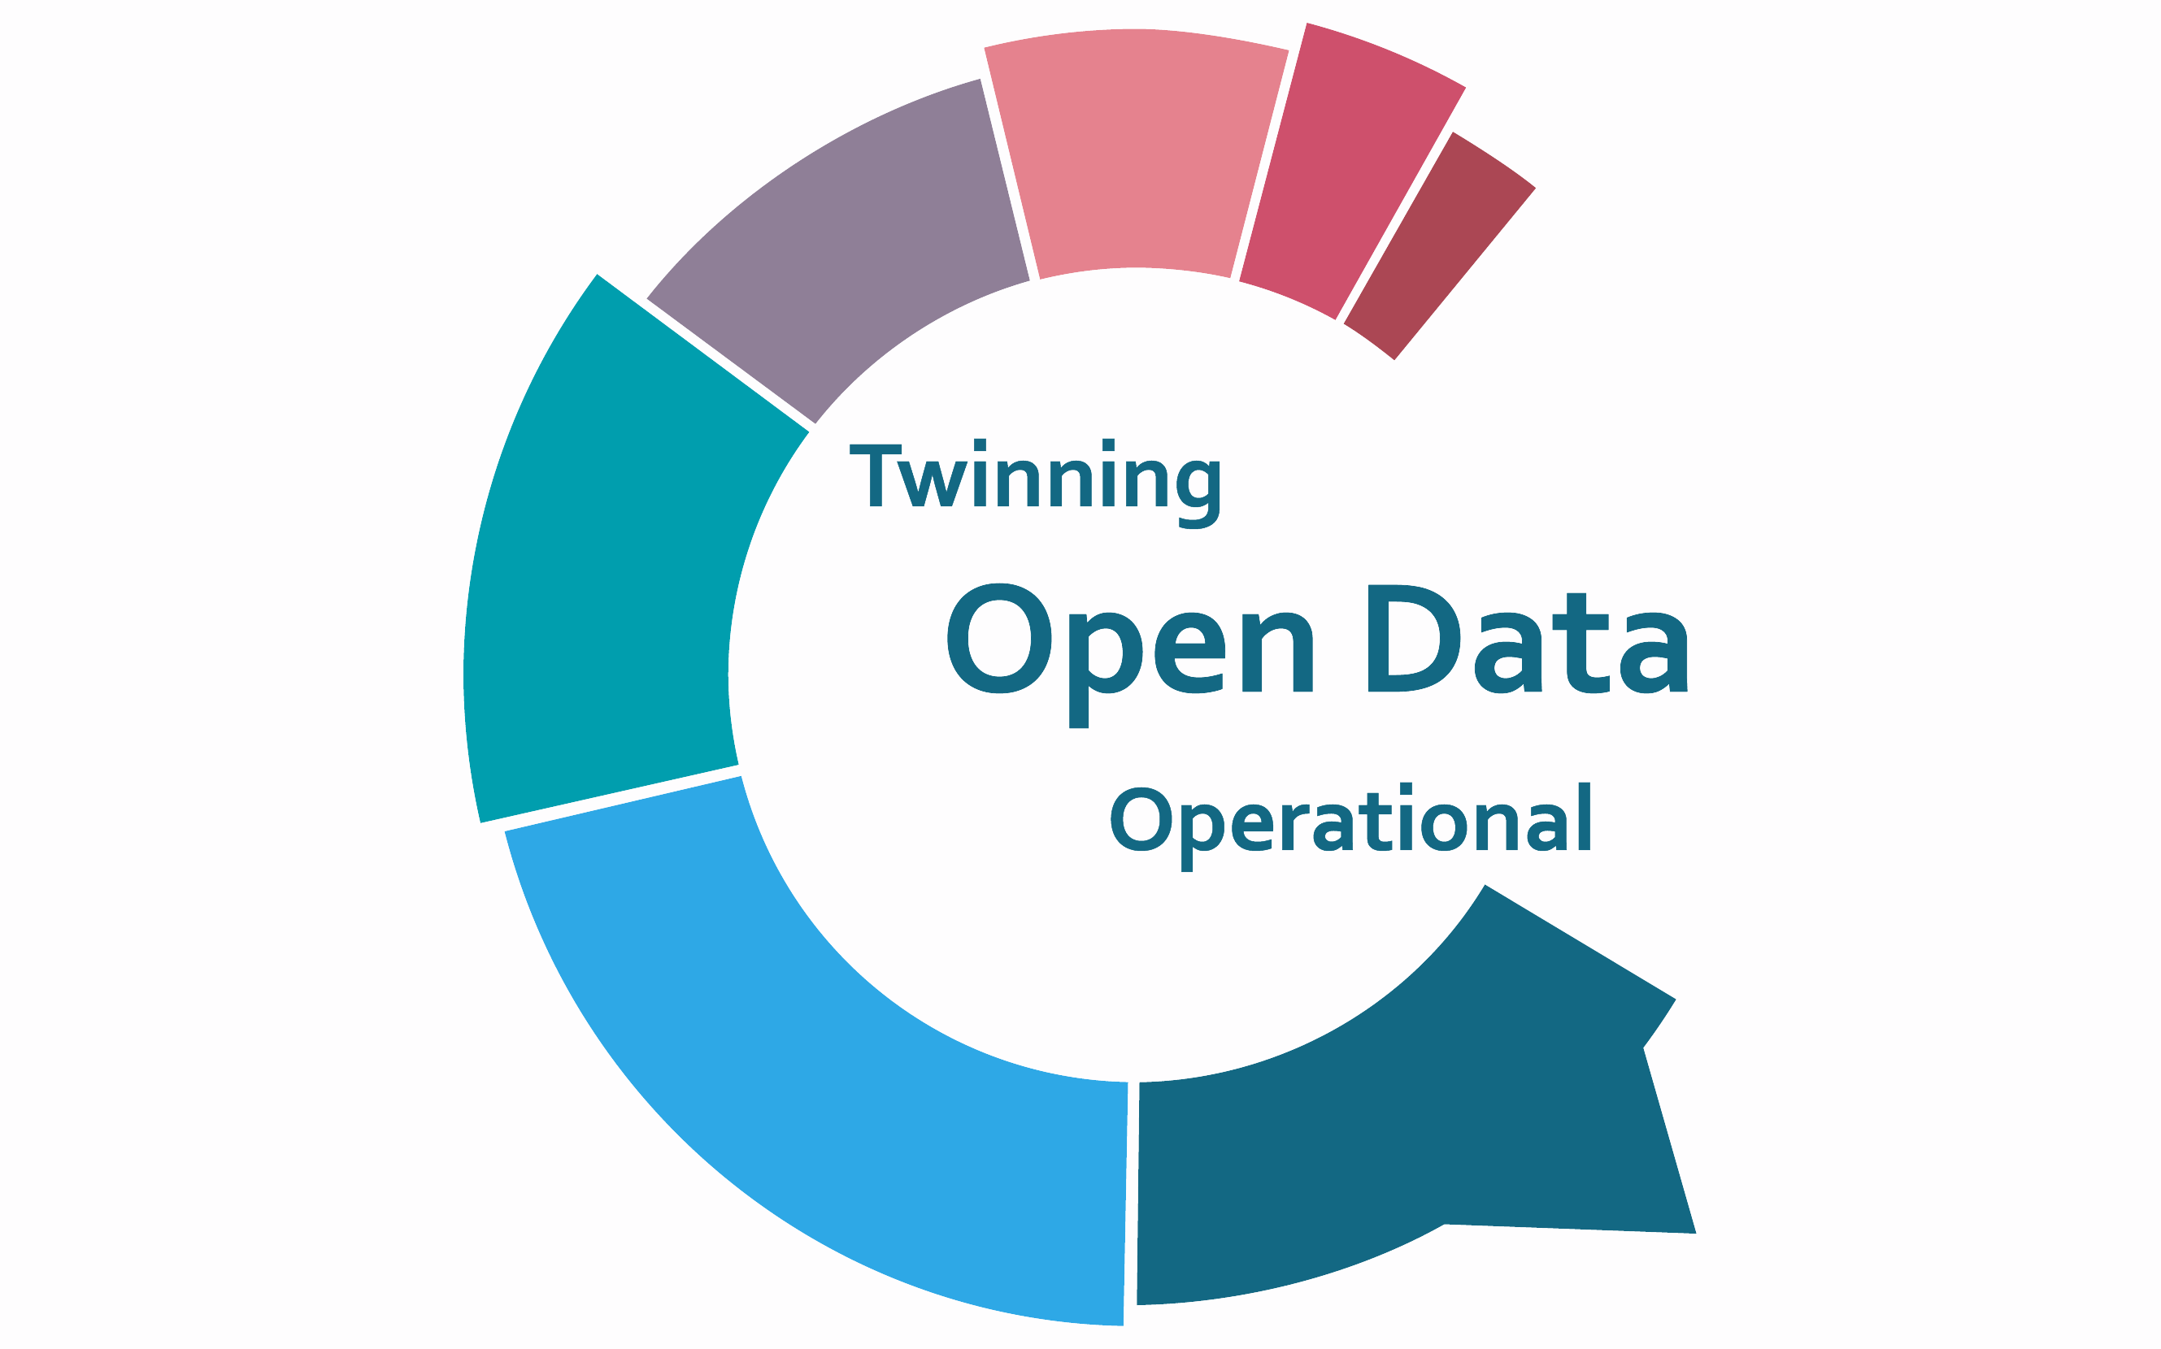



CHECK OUR ACTIVE PROJECTS
RAPIDE: Relevant assessment and pedagogies for inclusive digital education, Erasmus+, 2021-2023
T4E4: Accelerating the transition towards Edu 4.0 in HEIs, Erasmus+, 2020-2023
AMED: Advancing higher education in Maldives through E- learning Development, Erasmus+, 2019-2022
TODO: Twinning Open Data Operational, Horizon 2020, 2019-2022
ORKAN: Unmanned Aerial Vehicle Policy Ecosystem, HRZZ, 2020-2024
HELA: Improving HEI maturity to implement learning analytics, HRZZ, 2021-2025
O-HAI 4 Games: Orchestration of Hybrid Artificial Intelligence methods for computer Games, HRZZ, 2020-2024
rapide-project.eu
teach4edu4-project.eu
amed-project.eu
todo-project.eu
orkan.foi.hr
decision-lab.foi.hr/hela-projekt

Slide 6

FOI EXCELLENCE RESEARCH GROUPS
Artificial Intelligence Laboratory
Business Process Management and Digital Transformation Laboratory
Enterpreneurship Laboratory
IOT Laboratory
Laboratory for Advanced Technologies in Education
Laboratory for Data Technologies
Laboratory for Design of Program Interfaces, Internet Services and Videogames
Laboratory for ERP Systems and Interoperability
Laboratory for Generative Programming and Machine Learning
Learning Analytics Laboratory
Laboratory for Web Architectures, Technologies, Services and Interfaces
Laboratory for Applied Software Engineering

Slide 7

INTERNATIONAL
COOPERATION
FOI is dedicated to foster internationalization processes and it is open for academic partnerships with higher education institutions across the world, in students and staff exchange, research and project cooperation.
Established in 2002 FOI International Relations Office is a facilitator and a promoter of our international activities.

Slide 8
ERASMUS+ AGREEMENTS AND PARTNER INSTITUTIONS
Amsterdam University od Applied Sciences, Netherlands
EPITECH, Paris Graduate School od Digital Innovation, France
Faculty od Business, Babeș-Bolyai University, Romania
Faculty od Information Studies in Novo Mesto, Slovenia
Faculty od Organisation Studies in Novo Mesto, Slovenia
ESIEA - Graduate Engineering School, France
Karslruhe Institute of Technology, Germany
Koç University Instanbul, Turkey
Mälardalen University, Sweden
Mendel University in Brno, Czech Republic
Mykolas Romeris University, Lithuania
Odisee University College Brussels, Belgium
Pamukkale University, Turkey
Slovak University of Technology in Bratislava, Slovakia
Ss. Cyril and Methodius University in Skopje, North Macedonia

Slide 9
ERASMUS+ AGREEMENTS AND PARTNER INSTITUTIONS
University of Alcalá , Spain
University of Deusto, Spain
University of Graz, Austria
University od L’Aquila, Italy
University of Maribor, Slovenia
University of Oulu, Finland
University of Pécs, Hungary
University of Porto, Portugal
University of Seville, Spain
University of Twente, Netherlands
University of Žilina, Slovakia
UPEC, University Paris-Est Créteil, France

Slide 10

OTHER BILATERAL AGREEMENTS
Carlow University, USA
Kyrgyz State University of Construction Transport and Architecture, Kyrgyzstan
Leibniz Institute for Psychology Information (ZPID)
National Taipei University of Nursing and Health Sciences, Taiwan
National Taiwan University, Department of Computer Science and Information Engineering, Taiwan
Talas State University, Kyrgyzstan
University of Belgrade, Faculty of Organisational Sciences, Serbia
University of Central Florida, USA
University of Cincinnati, USA
University of Shkodra „Luigj Gurakuqi“/ Universiteti i Shkodrës "Luigj Gurakuqi", Albania

Slide 11

FOI BECAME PARTNER IN CEEPUS NETWORK
„Application and adaptation for e-learning systems in the field of industrial engineering in the Central European region”
FOI SIGNED 4 NEW ERASMUS+ AGREEMENTS
                Karlsruhe Institute of Technology, Germany
      University of Deusto, Spain
      University of Oulu, Finland
      Koç University Instanbul, Turkey
NEWS UPDATE IN 2020/2021

Slide 12
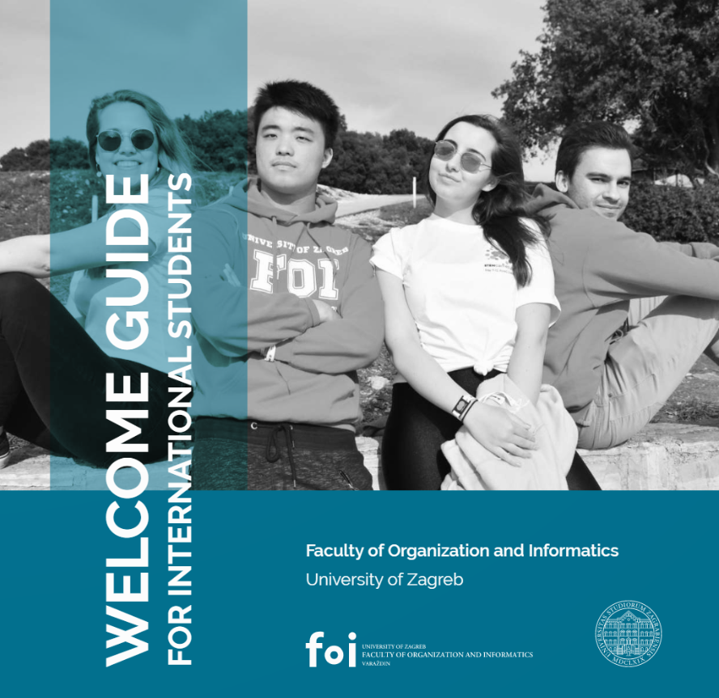
WELCOME GUIDE FOR
INTERNATIONAL STUDENTS
Intended for international students who decided to study at FOI by joining an exchange programme or as free movers.
It is designed to make your international academic experience
even more enjoyable and friutful.

Slide 13

WHY EXCHANGE STUDENTS LIKE FOI?
Friendly atmosphere
Open communication
Welcoming home students
Helpful staff
Fun activities and time spent together

Slide 14

COURSES IN ENGLISH
COURSE CATALOGUE offers 40 courses in English
Mixed courses from different study levels
Mixed courses from different study programmes
Enroll short intensive programmes (workshops)
Each academic year, more courses in English are added in course catalogue

Slide 15




A good relationship starts with good communication.
FACULTY OF ORGANIZATION AND INFORMATICS
International Relations Office
international@foi.hr
Centre for International Projects (CMP)
Pavlinska 2, 42000 VARAŽDIN
CMP@FOI.HR
projekti.hr

