Slide 1
Proposal for Cooperation

Slide 2
PORT-network is an International company. We have been presented in Hungary since 1996, in Romania since 2000, in the Czech Republic, since 2005, in Slovakian since 2007, in Croatia at the beginning of 2008, and in Serbia since 2009.
PORT.hr provide cinema, theatre, concerts, festival and clubs programme information and also has increasing database

Slide 3
Port-network
15 years know how on database management
biggest database on culture in the region
6 countries
database on 6 languages
approx. 400 tv channels
approx. 1.000 theatres
approx. 2.500 museums
approx. 3.000 clubs
festivals and special events
110 employes in 6 countries
strong IT background

Slide 4
Port-network / port.hr
8 employees in Zagreb office
Dedicated editors on each vertical content such as:
  National and localized tv channels
  Theater
  Exhibition
  Music
  Festivals
  Special events
  Editor in chief
  Marketing
  Journalist /publicist

Slide 5
Port-network / port.hr
8 employees in Zagreb office - 15 years know how
Direct contact with the event organizers
Daily contact
Email / phone / personal contacts
Press conferences
We know all the main players
We are informed about all the planned events
We got info for our database
We give publicity for events

Slide 6
Port-network
B2C services - PORT-network has approx. 400.000 unique visitors daily
B2B services –
  EPG for IPTV, digital, cable and satellite TV operators,
  teletext,
  Wap
  mobile operators (cultural events),
  printed newspapers and magazines and online platforms
Plans: Bosnia i Hercegovina, Russia and Turkey

Slide 7
Port ticketing
PORT ticketing is part of Port-network
PORT ticketing deals with:
  Selling tickets
  - Event management support
  - Equipment rental for events

Slide 8
Port ticketing
DATA BASE
+
ACCESS CONTROL

Slide 9
Port ticketing
PORT-network is natural source of finding information on where to go out,
  biggest database on culture in the region
we offer information on all
  theatrical performances,
  cinema screenings,
  concerts,
  exhibitions,
  festivals, etc. ..

Slide 10
Port ticketing system advantages
Database content
SERVICE for the sales channels:
  Web,
  retail,
  sales on mobile devices
all the processes are covered as
  web sales,
  sales at cash registers,
  access control at the event
promotions and sales events in the region

Slide 11
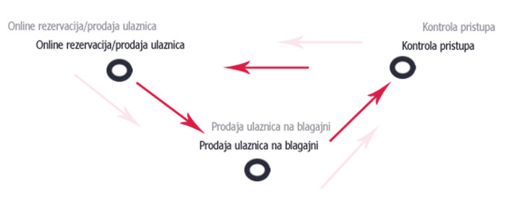
The process of system

Slide 12
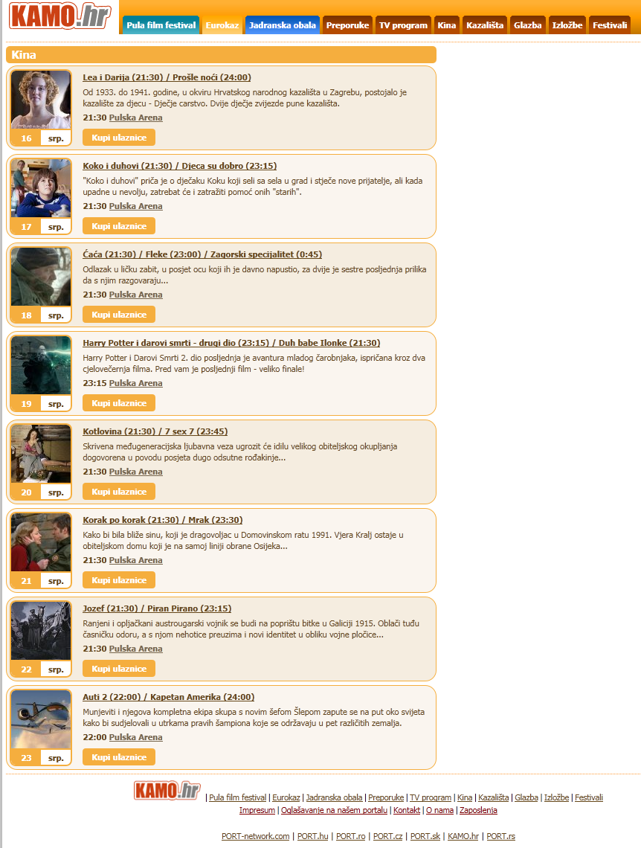
Application use:
Clicking selects the event to purchase and click the "buy ticket" approach to the next step.

Slide 13
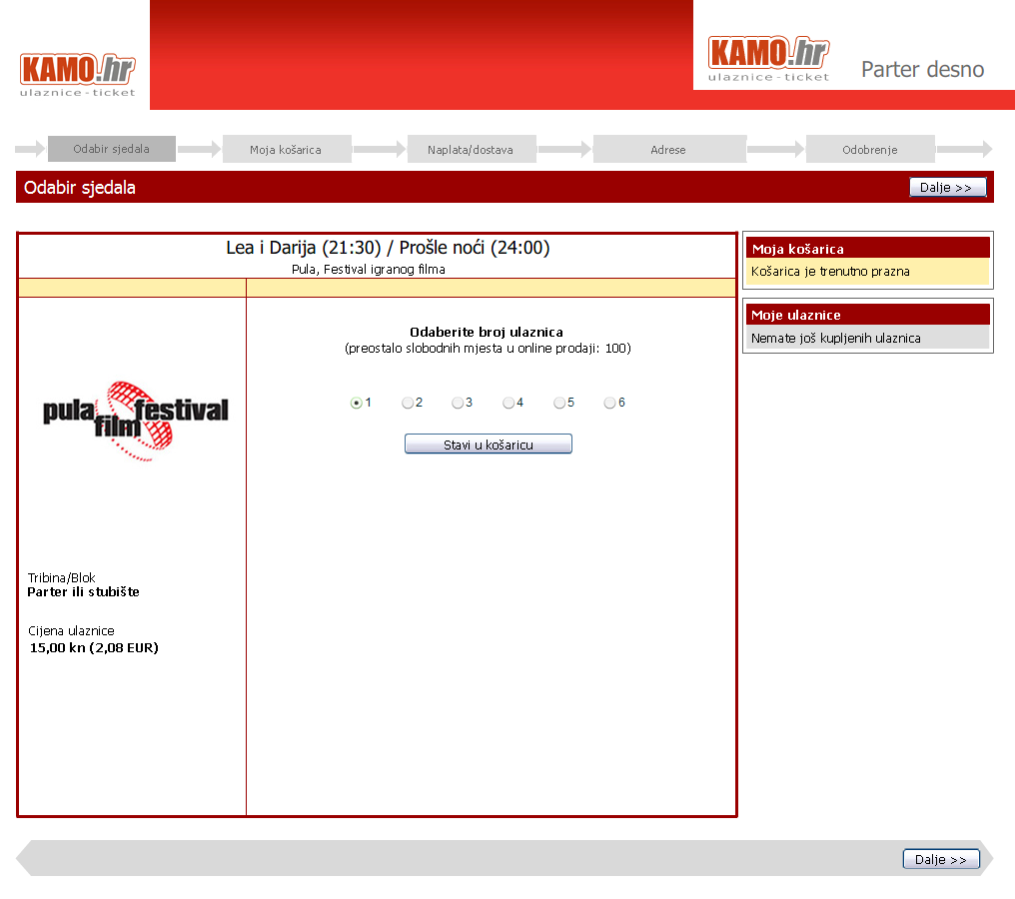
After the election of show, choose the number of seats - seats that you want to buy and press "Add to cart ...

Slide 14
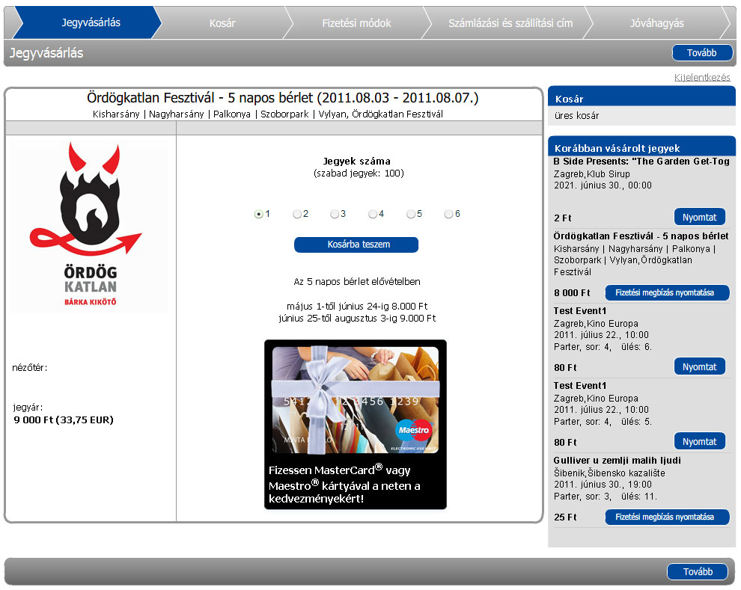
Example of second design of application

Slide 15
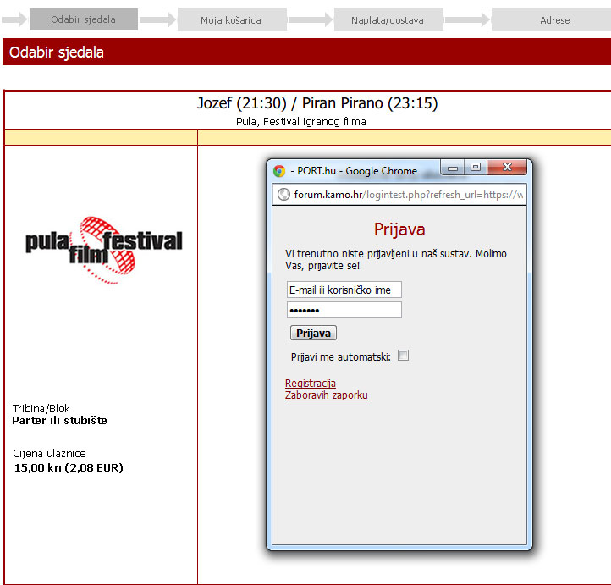
To be able to buy a ticket, you must be registered as a user, the application asks you for your password

Slide 16
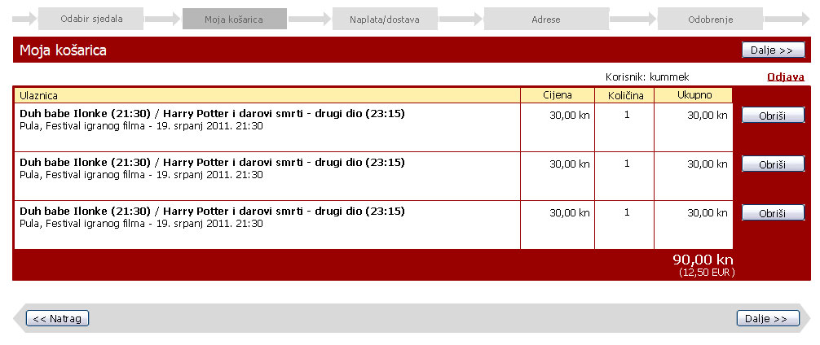
System before charging again shows an overview of the purchased ticket, and offers the opportunity to delete the selected ticket

Slide 17
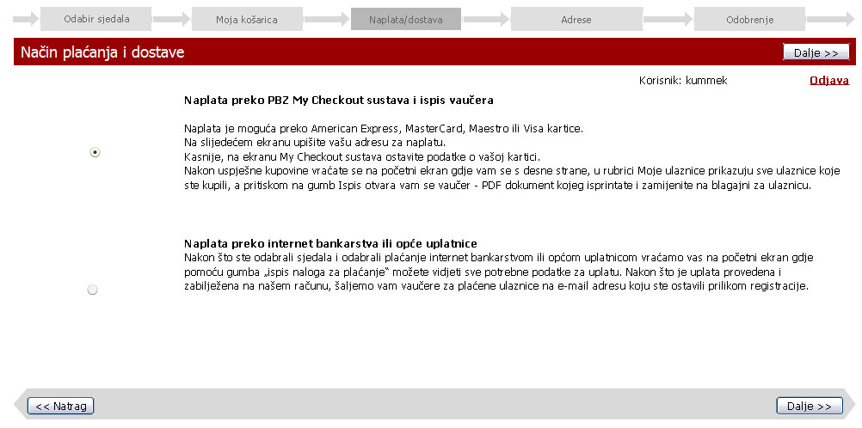
Select your preferred payment method

Slide 18
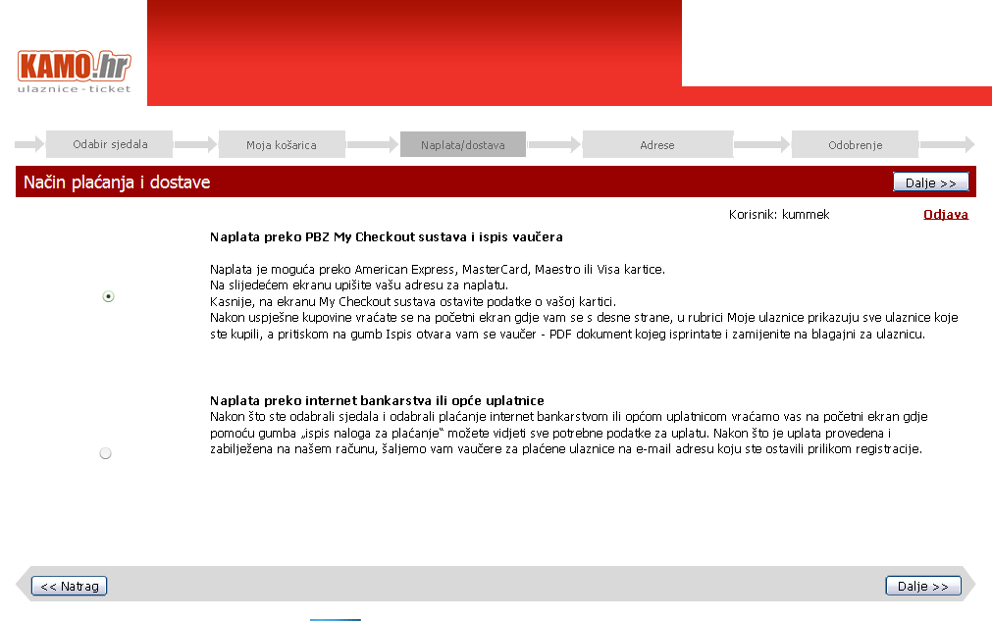
Payment method we support:
Bank cards
Wire transfer
Vouchers

Slide 19
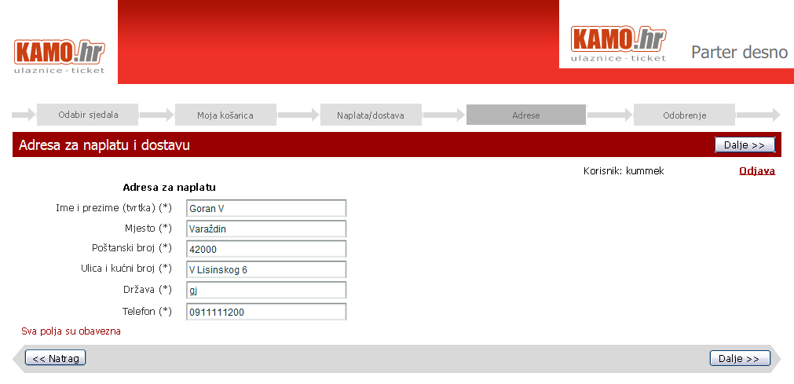
The buyer verifies his data

Slide 20
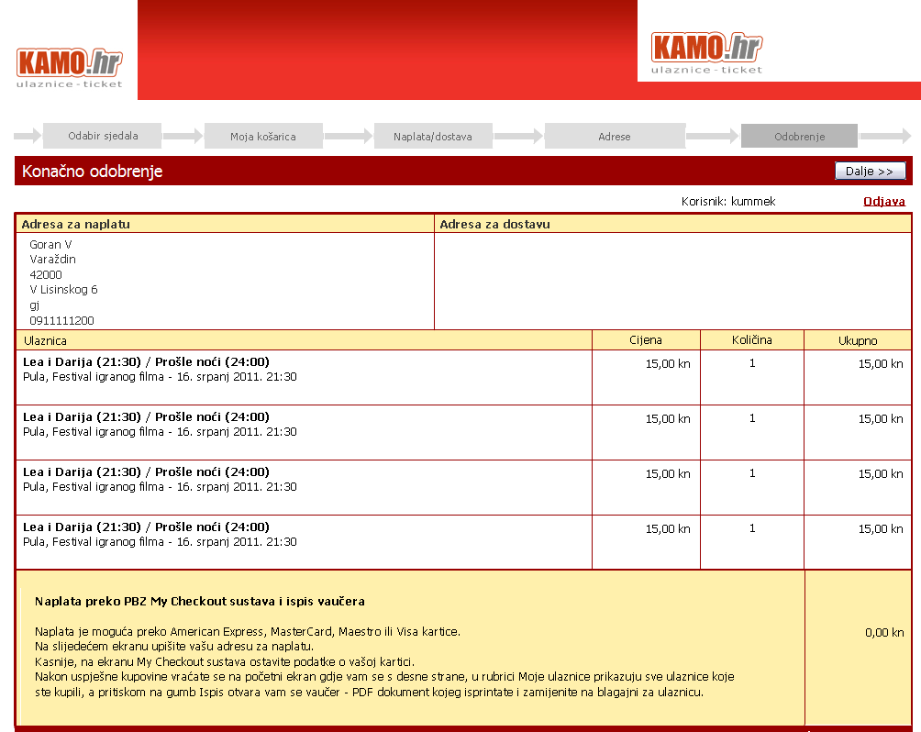
Final approval - list of selected sites, and the cumulative costs

Slide 21
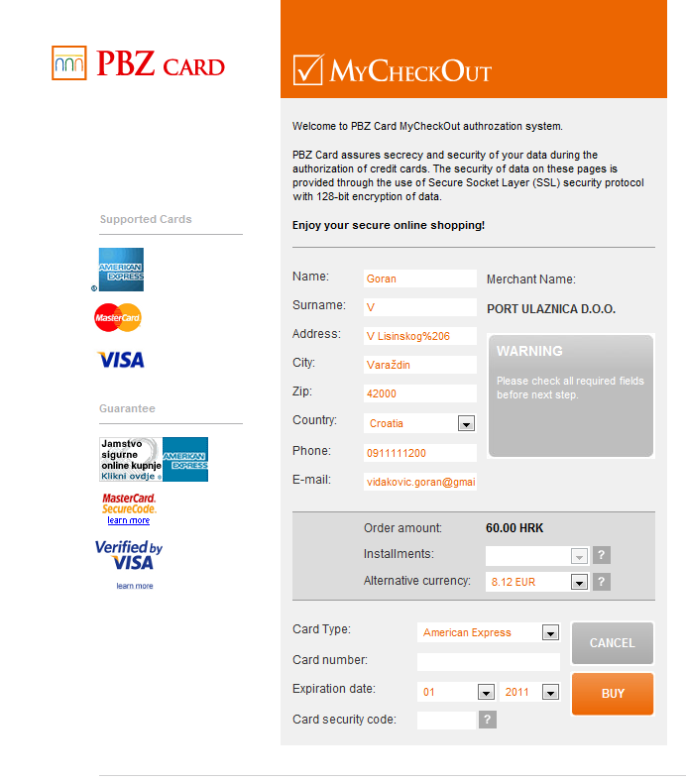
The last step - voucher with all necessary data ...

Slide 22
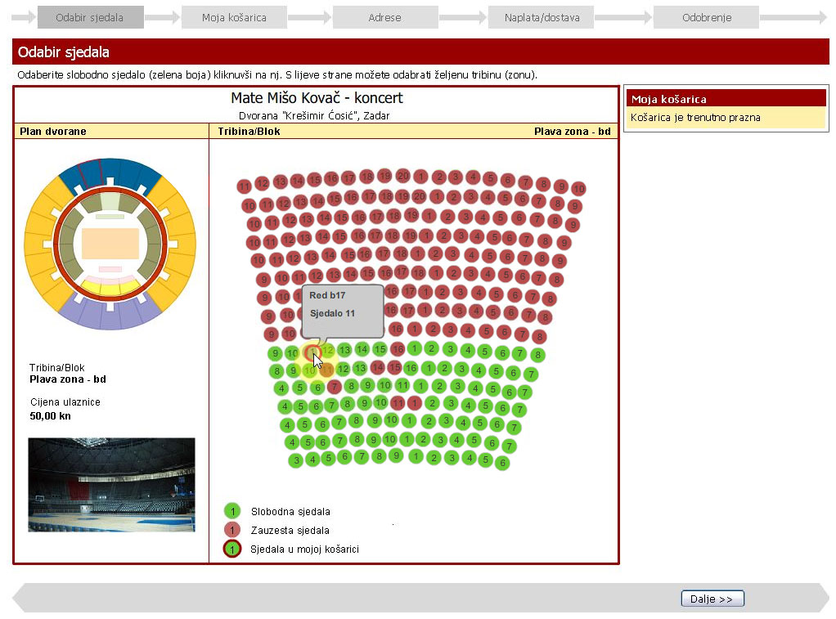
Example of venue with numerated seats

Slide 23
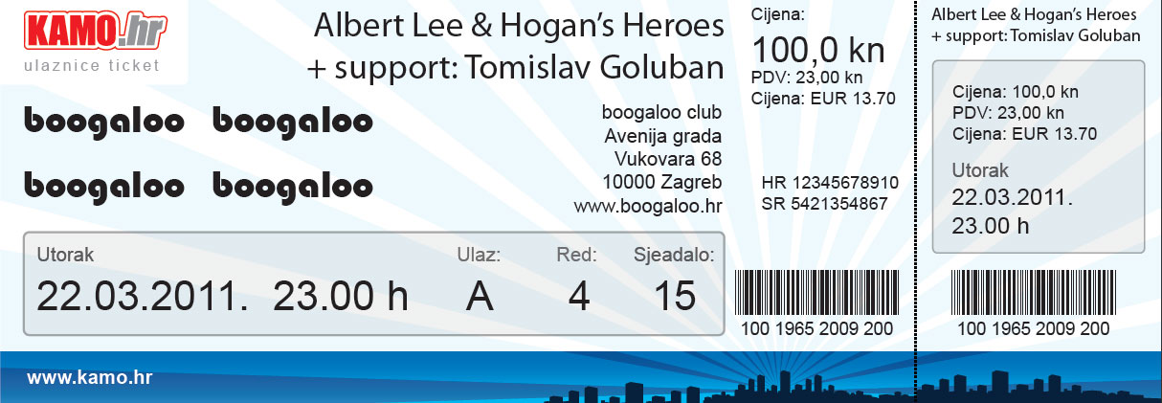
Primjer ulaznice

Slide 24
110 employees in 6 countries
IT department in Budapest and Varaždin: > 30
Data department in Croatia: 8

Slide 25








Some of references

Slide 26
Thank you for your attention!

